Slide 1
Surf Like A Pro: Using ITU Databases & OER
January 17, 2018
By Marion Hayes, University Librarian
ITU Library Website

Slide 2

AFTER THIS WORKSHOP YOU WILL BE ABLE TO:
Importance of research
Identify scholarly information
Locate scholarly resources
Practice “smart” search strategy
Practice search strategy using using ITU databases
ITU Library Website
5/18/17

Slide 3
What is Research?
Ability to source, select, use and share credible, verified and reviewed information in an honest, legal and ethical way.
Marion Hayes, ITU University Librarian
ITU Library Website
5/18/17

Slide 4
The Research Cycle
Define Purpose
←←←←←
Organized, orderly and back-and-forth process involve many steps the first of which is identifying and sourcing scholarly research information
Reflect
Search Access
Acknowledge
Cite
Write
Communicate
Honesty
**
Acknowledge, Cite, Ethical Use
Evaluate Select
Use Apply
Based on: Framework for Information Literacy for Higher Education,. Association of College & Research Libraries (ACRL) 2000.
ITU Library Website

Slide 5
Search Like A Pro
Use the 6-step formula to plan, research and write a successful scholarly paper
Use library databases to refine, source, cite & present your paper with academic honesty
Know the tools for efficient & ethical research – Reference Manager, turnitin, ITU style guides
ITU Library Website
5/18/17

Slide 6
Tools of a Pro Searcher
#1: Library Catalog & E-Resources
#2: Master’s Thesis Guidelines
#3: Doctoral Dissertation Guidelines
#3: ITU Style guides, APA Format
#4: ITU Plagiarism Prevention Policy
#5: Fake or Fact: Library Workshop
#8: Say No to Plagiarism: Library Workshop
ITU Library Website
5/18/17

Slide 7
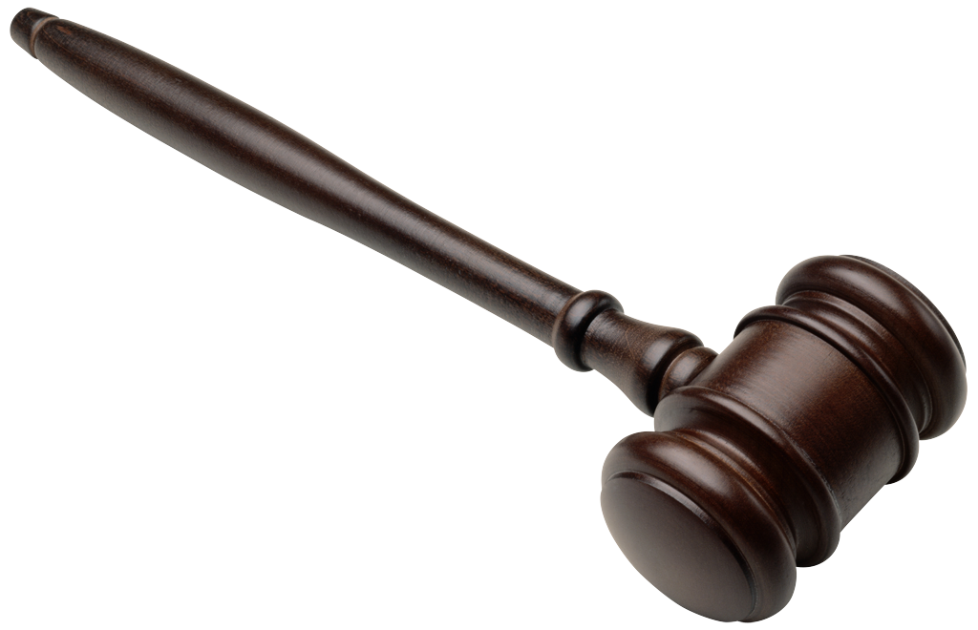
Identifying Scholarly Information?
Criteria | Tips
Authority / Publisher | Peer-reviewed, Expert, Opinionated, Factual, No Bias, Reputation
Organization | .gov .edu .org .com .net; Contents, Index
Currency | Last updated? Active links?
Accuracy | Sources? Citations, Verified?
Coverage /Scope | Relevance, sufficient details
Objectivity / Bias | Opinion or fact? propaganda
Questionnable | News – Popular – blogs – tabloids - no author/contents – publisher - date
Appropriate | Task, audience, advertising (agenda)
ITU Library Website

Slide 8
What is Research/Information Literacy
”
Information Literacy Why Is It Important
Presented by
the Association of College Research Libraries (ACRL)
https://www.youtube.com/watch?v=ciSWknQ98o8
QUESTION:
How is Information Literacy important to our success, wellbeing and satisfaction at work and outside work?
ITU Library Website

Slide 9
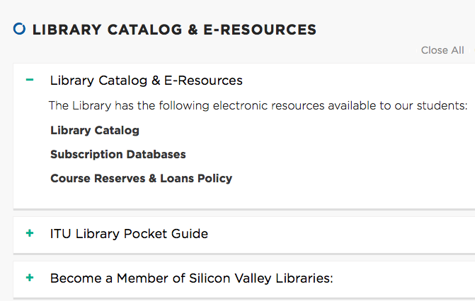
ITU Databases
Go to the ITU Library Website -
Scroll down to “Library Catalog & Resources
ITU Library Website

Slide 10
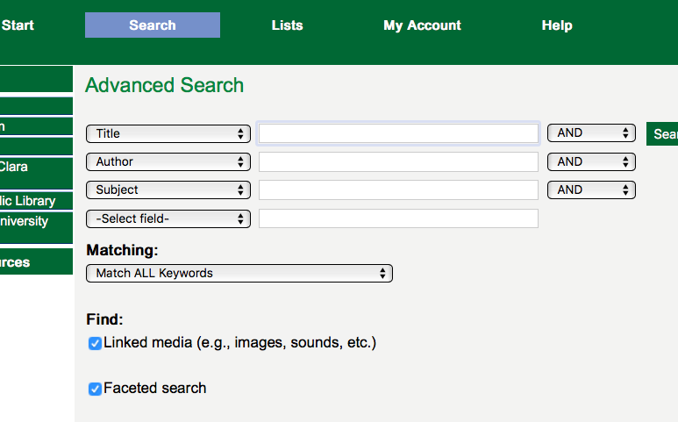
ITU Library Catalog
Go to the ITU Library Website -
Scroll down to “Library Catalog & Resources
Open “Library Catalog”
ITU Library Website

Slide 11
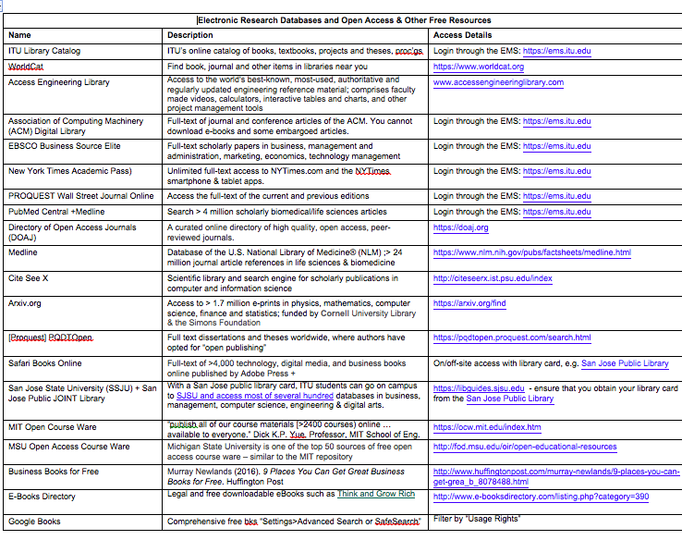
Subscription Databases
Go to the ITU Library Website > Scroll down to “Library Catalog & Resources>Open “Subscription Databases”
ITU Library Website

Slide 12
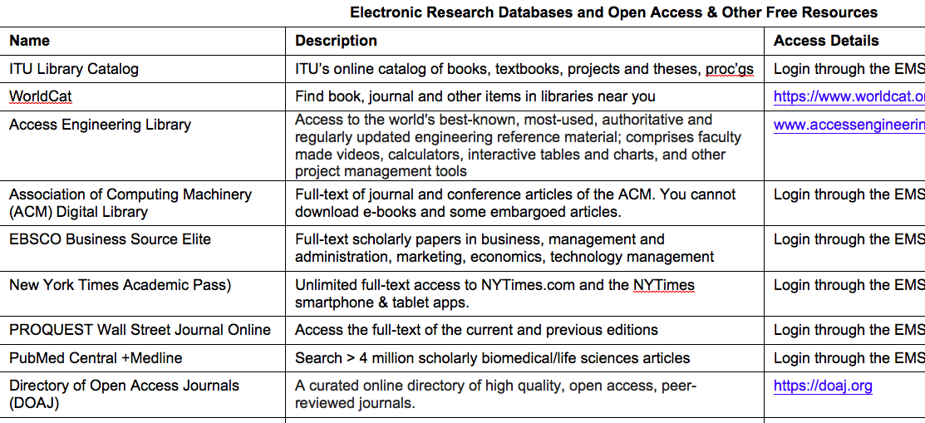
Subscription Databases
Go to the ITU Library Website > Scroll down to “Library Catalog & Resources>Open “Subscription Databases”
ITU Library Website

Slide 13
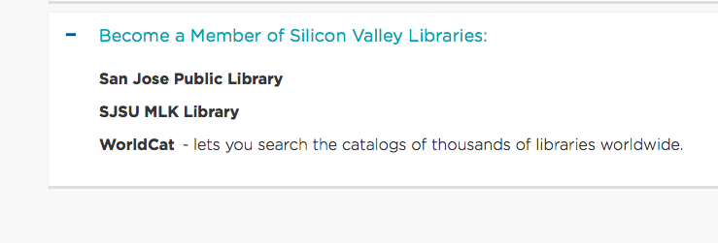
WorldCat, San Jose & Local Libraries
Go to the ITU Library Website > Scroll down to “Library Catalog & Resources>Open “Become a member of Silicon Valley Libraries
Take-a-way: Go to the website of your local public library, obtain a library card > check their databases > check their inter-library loan service; TIP: Note: Most PLs offer 1-6 ILLs per month with a small fee.
ITU Library Website

Slide 14


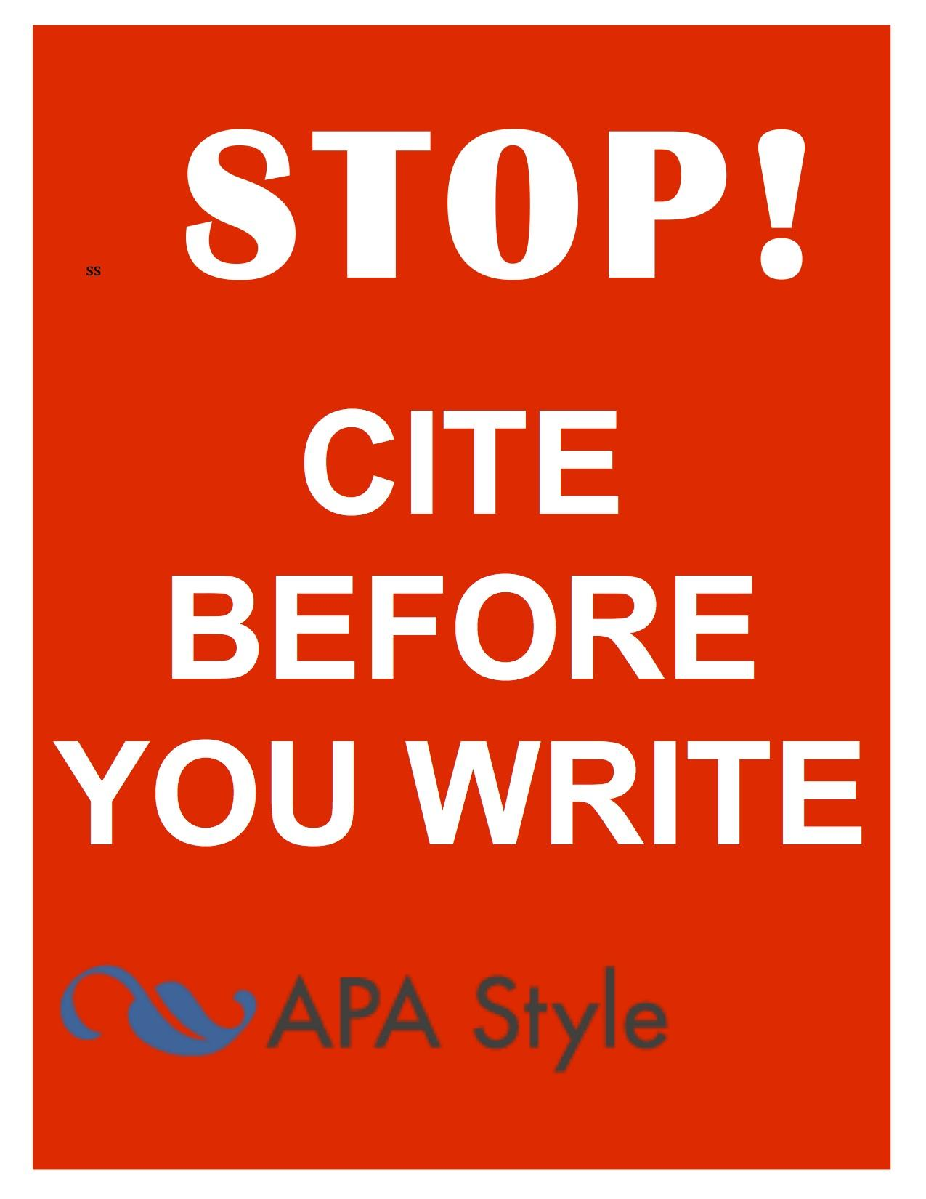
Remember this !

Slide 15
Academic Honesty
15
ATTENTION!!
Cheating, fabrication and plagiarism are unethical, behaviors at ITU see ITU’s Academic Dishonesty Policy and ITU Student Code of Conduct).
ITU defines plagiarism as:
“Representing someone else’s words, ideas, artistry, or data as one’s own, including copying another person’s work (including published and unpublished material, and material from the Internet) without appropriate referencing, presenting someone’s else’s opinions and theories as one’s own, or working jointly on a project, then submitting it as one’s own.”
Consequences - Failing or lower assignment/course grades, suspension/expulsion, loss of professional reputation, job or career.
2711 North First St. - San Jose, CA 95134 - www.itu.edu
library@itu.edu
11/7/17

Slide 16
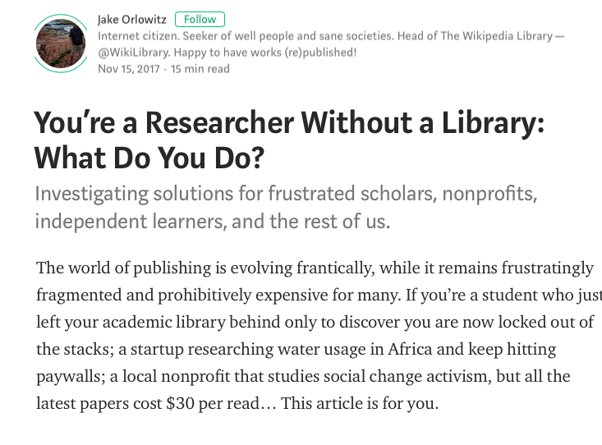
YOU’RE A RESEARCHER WITHOUT A LIBRARY, WHAT DO YOU DO?
https://medium.com/a-wikipedia-librarian/youre-a-researcher-without-a-library-what-do-you-do-6811a30373cd
5/18/17

Slide 17
CAN I GOOGLE? WHAT ABOUT WIKIPEDIA ? (Yes & No)
Google Scholar
Scholarly
“Advanced Search
Some are copyright-exempt
2. Google “Advanced Search” (Settings)
Limit by domain, title search only, file type
Good for images – select licensing desired
3. Wikipedia?
Scholarly? Background info.
Expert editors?
Reference lists with sections
4. What is a scholarly source?
5. Why use library databases?databases?
6. Free / Open Access Scholarly Database (EMS)
Google
Wikipedia
Library Databases
ITU Library Website
5/18/17

Slide 18
Using Google “Settings” for Pro Searching
From www.Google.com select “Settings” (bottom right screen)
Select “Advanced Search”
Select an option from “Usage Rights” such as “free to use share and modify”
To search for free to use images, go to Google images, change settings to “Advanced Search” and
Change Usage Rights to the option that best fits your use
Stark State Digital Library (2017). Copyright and Plagiarism Guide for Students
ITU Library Website
5/18/17

Slide 19
CRAAP Test: Identifying Scholarly Sources
Source: What Does Bad Information Look Like? - http://www.istl.org/18-winter/tips2.html
“Even within the realm of peer-reviewed literature, students still need to be able to think critically about the quality of information ”
Currency – date, last updated, enduring, broken links?
Relevance – topic, level of audience (child, adult)
Authority – peer review, author, publisher, .org, .edu, .gov
Accuracy – objective, unbiased, research protocol
Purpose – audience (academic, professional)
ITU Library Website
5/18/17

Slide 20
OPEN ACCESS (OA)
OPEN EDUCATIONAL RESOURCES (OER)
OA - online research outputs free of all restrictions on access and use (Wikipedia: https://en.wikipedia.org/wiki/Open_access
OER - free and openly licensed educational materials that can be used for teaching, learning, research, and other purposes (Creative Commons,https://wiki.creativecommons.org/wiki/What_is_OER%3F)
Examples:
ITU Electronic Information Resources (.xls) on the library website
Directory of Open Access Journals (DOAJ)
Arxiv.org
MIT Open Courseware
MSU Open Courseware
ITU Library Website
5/18/17

Slide 21
OPEN ACCESS (OA)
OPEN EDUCATIONAL RESOURCES (OER)
Local Library
University Library
State or National Library
Online Libraries (Internet Archive, Open Library
Free Preprints & Repositories
University Repositories
University Libraries
Subject Repositories (Openly Published – Medline)
Google Scholar
Pay-per-view
Examples:
ITU Electronic Information Resources (.xls) on the library website
Directory of Open Access Journals (DOAJ)
Arxiv.org
MIT Open Courseware
MSU Open Courseware
Trove, WorldCat – World libraries holdings
Subject Databases - Medline
ITU Library Website
5/18/17

Slide 22
LIBRARY DATABASES
What library databases does ITU have
eLibrary tab in the EMS (onsite no passwords; login for off-site
ITU Online Library Catalog
ACM Digital Library
EBSCO Business Source Elite
NYTimes Academic Pass
Proquest Wall Street Journal
What are the best local libraries for research?
Joint SJPL & SSJU library (e.g. see LibGuides – 100s of databases)
Santa Clara University (e.g. see LibGuides – 100s of databases)
CA Public Libraries (e.g. Safari Books, Ebsco Source Elite
Google
Wikipedia
Library Databases
ITU Library Website
5/18/17

Slide 23
SEARCH TIPS
What common search tips and tools are used in most databases?
Example: MIT Search Tips Guide (Excellent)
Topic / question in one sentence
Background info (e.g. Wikipedia or Google)
Keywords or synonyms (similar)
Search strings
Boolean Operators AND, OR, NOT
Wildcards, truncation ? # book?
Stop word (e.g. ‘NOT’)
Sub topics
Keywords
Scholarly?
Limit?
Highly Recommended Source!!
MIT Libraries Search Tips, https://libguides.mit.edu/database-search, Accessed 18 Jan, 2018
5/18/17

Slide 24
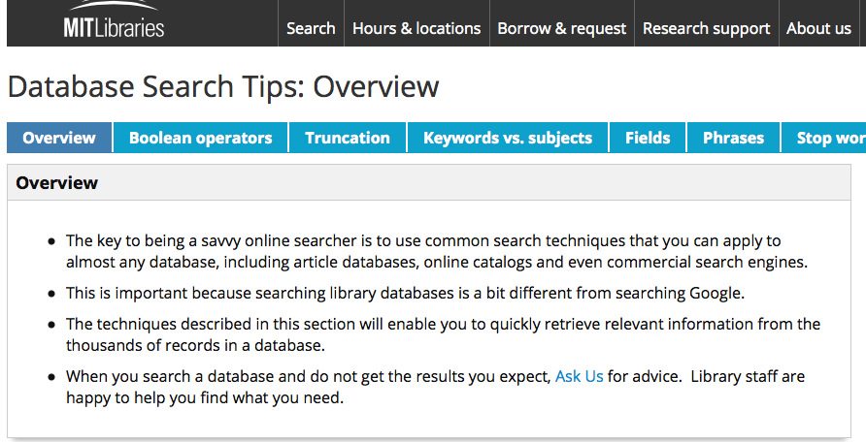
Scholarly Surfing
Highly Recommended Source: MIT Libraries, https://libguides.mit.edu/database-search, Accessed 18 January, 2018
ITU Library Website

Slide 25
EXAMPLE
“While potential benefits [to autonomous vehicles) are substantial, significant implementation and mass-market penetration barriers remain” (Daniel J. Fagnant, 2015. http://www.caee.utexas.edu/prof/kockelman/public_html/TRB14EnoAVs.pdf accessed Nov 8, 2017
In 1000 words, use scholarly literature to respond to this statement.
Step 1: Topic in one sentence (in own words)
e.g. What are the barriers to the widespread uptake of autonomous cars in the U.S.?
Step 2-3: Searching, selecting and saving citations (next page)
ITU Library Website
5/18/17

Slide 26
EXAMPLE:
Step 1: Topic in one sentence.
e.g. What are the barriers to the widespread uptake of autonomous cars in the U.S.?
Step 2: Find scholarly information and strategy
Keywords/phrases
Autonomous (vehicle* or car*) OR
Driverless / selfdriving / self-driving (vehicle* or car*) AND
market penetration or market barriers AND
Uptake or adoption or acceptance or …. AND
U.S.. or united states or north America AND
Databases:
Google: “Setting>Advanced Search”
ITU Library Catalog
Ebsco Business Source Elite
Search, Select, Download (Zotero, Mendeley)
Need help with Zotero or Mendeley? Submit a Library Inquiry or drop into the library.
ITU Library Website
5/18/17

Slide 27
How to surf like a pro
27
Did you receive your library logins
Use library catalog & databases for books, reserves, papers
Get a San Jose Public Library Card (SSJU Databases)
Know your Information literacy skills
Attend library webinars and workshops (flyer)
Get research help – library@itu.edu, research consultation
Know the research process – six steps (videos)
Use good search strategy, Boolean logic, keywords, wildcards
Know criteria to evaluate scholarly information
Use information legally – copyright, trademarks
Use information ethically - plagiarism, citation, turnitin
Use Tools/templates -ITU guides, APA style, turnitin, Zotero
2711 North First St. - San Jose, CA 95134 - www.itu.edu
library@itu.edu
11/7/17

Slide 28
REMEMBER TO
Schedule your research consultation with your University Librarian.
Email library@itu.edu
ITU Library Website
5/18/17

